Slide 1

Simulating Semantic Priming Using Word Embeddings
A Comparison of Word2Vec and SBERT
Rahul Pachal (2023HCS7024)
Nirbhay Gupta (2023HCS7019)

Slide 2


What is Semantic Priming?
Faster recognition of a word when preceded by a related word.
E.g., "doctor" primes "nurse" faster than "table" does.
This studied via Lexical Decision Task (LDT).
Notes:
Semantic priming refers to the phenomenon where people recognize a word faster if it is preceded by a related word.
For example, after seeing 'doctor,' people respond faster to 'nurse' compared to an unrelated word like 'table.'
This effect reveals how meanings are organized and accessed in the mind, and it's commonly studied using reaction time tasks like the Lexical Decision Task.
In this project, we aim to simulate this human behavior computationally using word embeddings.

Slide 3
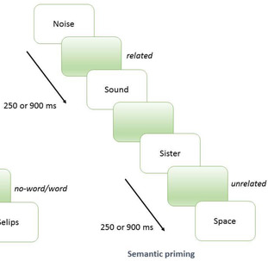


Psychological Background
Lexical Decision Task: Decide if target is a real word.
Measure: RT difference between related vs unrelated primes.
Shorter RT in related condition = stronger priming.
Notes:
Before we get into models, it's important to understand how semantic priming is measured.
In a Lexical Decision Task, participants are quickly shown a prime word and then a target word, and they have to decide if the target is a real word.
The interesting part is: if the prime and target are semantically related — for example, if you see 'doctor' first and then 'nurse' — your brain processes the target much faster, almost automatically, because the concepts are linked in memory.
The key measurement here is the Reaction Time, or RT. Researchers calculate how much faster people respond when the prime and target are related compared to when they are unrelated — like 'table' and 'nurse.'
This difference in reaction times is called the priming effect. A larger priming effect suggests that the two words are strongly connected in the mind.
Understanding this psychological setup is crucial, because my project is trying to simulate this exact phenomenon computationally — using word embeddings instead of human participants
.

Slide 4
Prior Approaches to Modeling Semantic Priming
Hutchison et al. (2013): Large-scale semantic priming dataset.
Latent Semantic Models (LSA, BEAGLE):Early models capturing word meaning from large text corpora.
Emergence of Neural Embeddings (Word2Vec, GloVe, BERT):
Recent studies link neural embeddings with RT-based priming
Notes:
In earlier research, scientists used simpler models like LSA (latent semantic analysis) and BEAGLE (Bound Encoding of the Aggregate Language Environment )to estimate how words were semantically related, and these models could moderately predict priming effects.
These models would read through huge text corpora, counting how often words appeared together, and based on that co-occurrence, they would generate vector representations for words.
Using these vectors, researchers could calculate the semantic similarity between two words — and they found that higher similarity scores moderately predicted faster reaction times in priming experiments.
However, these early models had limitations. They captured broad thematic similarity but often missed finer-grained associations like doctor-nurse or dog-leash.
With the development of neural embeddings like Word2Vec, GloVe, and BERT, we now have much richer and more powerful word representations.
Recent studies have focused on comparing these embeddings directly to human behavior — like reaction times in semantic priming — to see how well they capture human-like understanding of meaning.
So now we know prior models could predict priming to some extent, the real question becomes:
Can today's powerful embeddings like Word2Vec and SBERT actually simulate human reaction patterns even better?
Our project builds on this idea: we test whether Word2Vec and SBERT can simulate the semantic priming effect observed in real experiments

Slide 5
Research Problem
Can embedding-based similarity simulate semantic priming?
Compare Word2Vec (distributional) vs SBERT (contextual).
Hypothesis: Higher similarity → stronger priming (shorter RT).
Which model better captures human associative meaning?
Notes:
So, the central research problem I address in this project is quite direct:
Can modern word embeddings — specifically Word2Vec and SBERT — successfully simulate the semantic priming effect that we observe in human reaction times? if two words are closer together in the embedding space — meaning they have a higher cosine similarity —can we predict that people will respond faster to these pairs in a lexical decision task.
First, Word2Vec, which is a distributional model — it captures how words are used together in large text corpora but without any deeper understanding of context.
And second, SBERT, a contextual model — it’s based on transformer architectures, and it encodes not just word co-occurrence but also rich sentence-level information.

Slide 6
Dataset Description
1,600+ prime-target word pairs from LDT experiments.Z-score Reaction Time (ZRT) difference computed: (ZRT_unrelated - ZRT_related)
Includes psycholinguistic features: FAS, LSA, frequency.
Data cleaned and filtered for analysis (Word2Vec-compatible).
Notes:
We used a dataset that comes from the Semantic Priming Project by Hutchison and colleagues, conducted in 2013. it contains over 1,661 prime-target word pairs, each tested in a Lexical Decision Task setup, with human participants. For each word pair, they collected reaction times in two conditions — when the prime and target were semantically related and when they were unrelated. From this, they computed a Z-scored Reaction Time difference — that is, (ZRT_unrelated minus ZRT_related )—to quantify the priming effect in a way that normalizes for individual variability and task differences. We filtered out any missing values and ensuring that both the prime and target words exist in the embedding vocabularies, particularly for Word2Vec.
This gives us a high-quality set of word pairs where we can meaningfully compute cosine similarity scores between embeddings and directly test if these scores correlate with human priming effects.

Slide 7
Embedding Models
Word2Vec:Trained on Google News corpus (300-dimensional vectors).
SBERT (Sentence-BERT):Transformer-based, optimized for sentence and phrase similarity.
Cosine Similarity:Used to measure closeness between prime and target vectors.
Lowercased and vocabulary-filtered words for consistency.
Notes:
we chose two widely used and conceptually different types of embeddings: Word2Vec and SBERT.
Word2Vec, which is a distributional model — it captures how words are used together in large text corpora but without any deeper understanding of context.
SBERT( Sentence-BERT) is a contextual embedding model. To compare prime and target word vectors in both models, we used cosine similarity — a standard measure that calculates how close two vectors are in high-dimensional space. Also, to ensure fairness and consistency, we lowercased all the words before looking them up in the embedding vocabularies, because both Word2Vec and SBERT are case-sensitive.

Slide 8
Methodology
Extract prime-target pairs.
Compute cosine similarity between embeddings.
Compute priming effect from reaction times.
Correlate similarity scores with priming effects.
Visualize the relationships using scatter plots and regression lines.
Notes:
In our analysis, we computed the semantic similarity between primes and targets using embeddings and correlated that similarity with the observed priming effect — defined as the difference in reaction times between unrelated and related conditions. We also tested statistical significance to ensure our findings were not due to chance.

Slide 9
Preprocessing
Column Name | Why We Used It
prime_1st_assoc | The prime word (the first associated word used in the experiment)
target | The target word (participant had to respond whether it's a real word)
short_1st_rel | Reaction Time (Z-scored) when prime and target are related, short Inter Stimulus Interval (ISI), first association
short_1st_un | Reaction Time (Z-scored) when prime and target are unrelated, short ISI
priming_effect | Computed by us: short_1st_un – short_1st_rel (Difference: how much faster participants responded when prime was related)

Slide 10
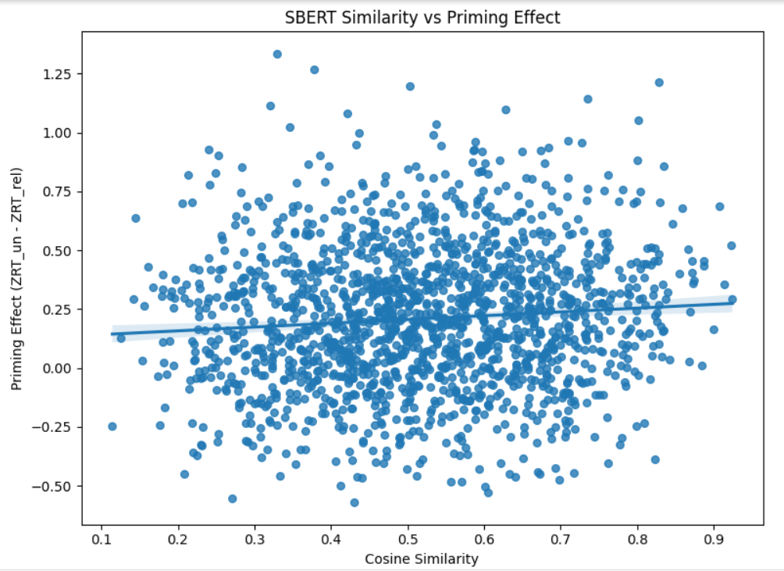
SBERT Results
Correlation: +0.0861
p-value: 4.46 × 10⁻⁴ (Highly Significant)
Notes:
SBERT, although trained for contextual sentence understanding, shows a statistically significant positive correlation with priming effects. However, the correlation is relatively modest, suggesting that while SBERT captures semantic closeness, it may not prioritize direct associative strength important in priming.

Slide 11
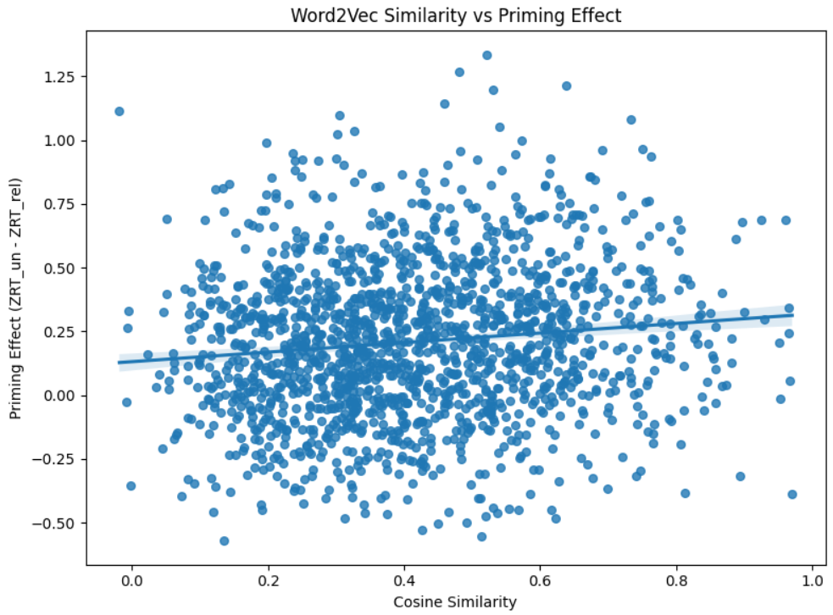
Word2Vec Results
Correlation: +0.1191
p-value: 1.17 × 10⁻⁶ (Highly Significant)
Notes:
Word2Vec shows a higher correlation with the priming effect compared to SBERT. Despite being a simpler, non-contextual model, it captures human associative links more directly, aligning better with behavioral reaction time data.

Slide 12
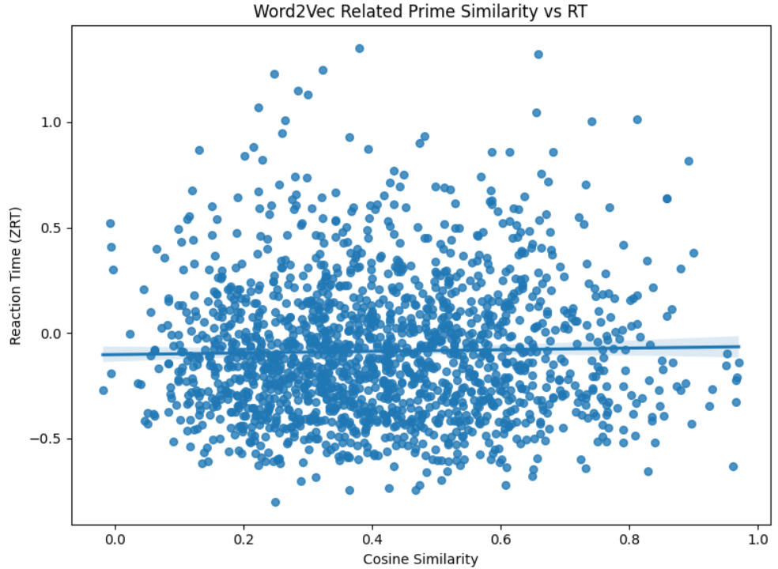
Word2Vec - Related Similarity vs RT
(Added based on feedback)
Correlation: +0.0224
p-value: 0.363 (Not Significant)
Notes:
Correlation is very close to zero and not significant.
Word2Vec similarity does not predict how fast people respond in the related condition.
Interpretation: Even if prime and target are semantically close in Word2Vec, it doesn't linearly relate to faster RTs.

Slide 13
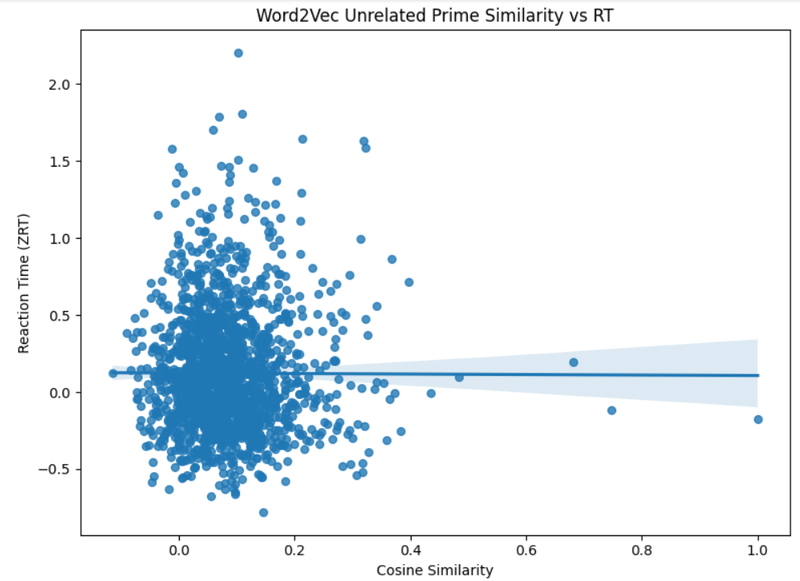
Word2Vec - Unrelated Similarity vs RT
(Added based on feedback)
Correlation: –0.0034
p-value: 0.889 (Not Significant)
Notes:
The Word2Vec similarity between unrelated primes and targets is not predictive of RTs either.
Expected, since unrelated primes are meant to be non-associative.

Slide 14
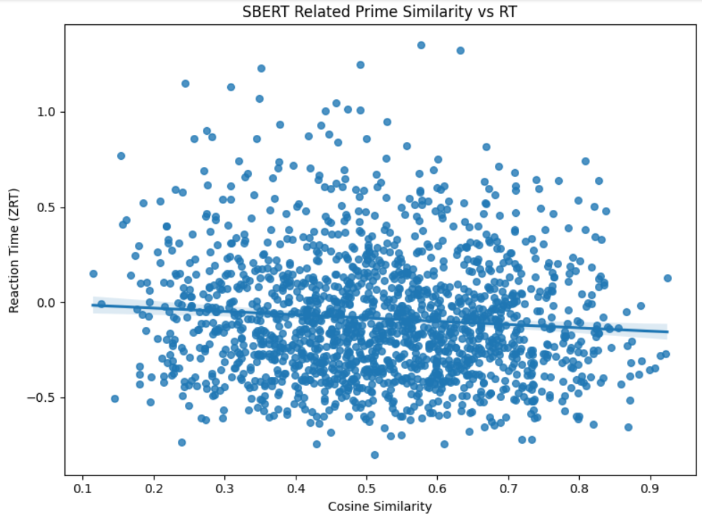
SBERT - Related Similarity vs RT
(Added based on feedback)
Correlation: –0.0848
p-value: 0.0006
(Significant)
Notes:
Negative correlation → as similarity ↑, RT ↓ (faster)
SBERT captures a weak but real effect: more semantically similar prime-target pairs lead to faster RTs in the related condition.

Slide 15
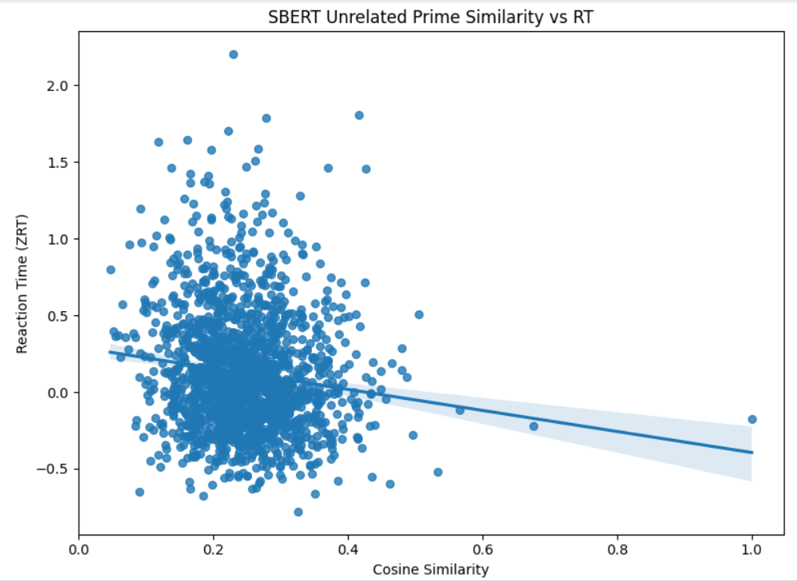
SBERT - Unrelated Similarity vs RT
(Added based on feedback)
Correlation: –0.1296
p-value: 1.26e–07
(Highly Significant)
Notes:
Even unrelated pairs with high SBERT similarity are associated with faster RTs
Indicates SBERT detects deep semantic relationships even in pairs labeled as "unrelated" in the experiment.

Slide 16
FINDINGS
(Added based on feedback)
SBERT similarity (related condition) is negatively correlated with RT → More similar = Faster RT
SBERT similarity (even in “unrelated” condition) is also correlated → SBERT sees latent semantic similarity even where humans don’t
Word2Vec shows no direct relationship with RTs — it works better when comparing priming effects (unrelated vs related)

Slide 17
Discussion
Both correlations are statistically significant (p < 0.001).
Word2Vec (r = 0.1191) > SBERT (r = 0.0861) in predicting priming effects.
Word2Vec better reflects associative strength crucial for semantic priming.
SBERT captures conceptual semantic similarity but not pure association.
Embeddings provide meaningful cognitive approximations but are not complete models.
Notes:
Our findings suggest that while both embedding models capture human-like semantic structures, Word2Vec's simple co-occurrence statistics more closely model the associative processes underlying semantic priming. The statistical significance of both correlations supports the reliability of our approach. However, embeddings still simplify meaning and do not fully capture all cognitive nuances.

Slide 18
Limitations & Future Work
Correlations are small (~0.1): semantic priming is noisy and influenced by many factors.
Analysis limited to isolated word pairs — no sentence context.
Embeddings trained on text, not designed to mimic cognition.
Future work: incorporate psycholinguistic features like FAS, POS, concreteness; explore sentence-level or multimodal embeddings.
Notes:
In future work, it would be very exciting to extend this kind of analysis by:
Including additional psycholinguistic variables, like Forward Association Strength (FAS), part-of-speech (POS) tags, and concreteness ratings.
Building regression models that combine embedding similarity with these human-rated variables.
Exploring sentence-based embeddings like Sentence-T5 or larger models like GPT-derived vectors, which might capture richer conceptual structures.\n- Even integrating multimodal embeddings — models that combine text, images, and experience — to better reflect how humans actually learn and relate concepts.

Slide 19
Conclusion
Word2Vec and SBERT embeddings successfully predicted human priming effects.
Word2Vec (co-occurrence-based) outperformed SBERT (context-based) in capturing associative strength.
Both correlations were statistically significant (p < 0.001).
Embeddings offer a computational window into human semantic memory, although they simplify the complexity of cognition.
Future directions: Enhancing embedding-based models with psycholinguistic features can further bridge the gap between AI and cognitive science.
Notes:
In conclusion, this study shows that embedding-based semantic similarity aligns with human semantic priming patterns. Word2Vec, with its simpler associative structure, more closely modeled human reaction times than SBERT. The statistically significant findings suggest embeddings can indeed simulate aspects of meaning processing, although further refinement is needed to capture the full richness of human semantic memory.

Slide 20
References
Hutchison, K. A., Balota, D. A., Neely, J. H., Cortese, M. J., Cohen-Shikora, E. R., Tse, C. S., ... & Buchanan, E. (2013). The semantic priming project. Behavior research methods, 45, 1099-1114.
Yap, M. J., Hutchison, K. A., & Tan, L. C. (2016). Individual differences in semantic priming performance: Insights from the Semantic Priming Project. In Big data in cognitive science (pp. 212-235). Psychology Press.
Reimers, N., & Gurevych, I. (2019). Sentence-bert: Sentence embeddings using siamese bert-networks. arXiv preprint arXiv:1908.10084.
Mandera, P., Keuleers, E., & Brysbaert, M. (2017). Explaining human performance in psycholinguistic tasks with models of semantic similarity based on prediction and counting: A review and empirical validation. Journal of Memory and Language, 92, 57-78.

Slide 21
Code GitHub Link
https://github.com/nirbhay002/Computational-Model-of-Meaning/tree/main

